Slide 1

Natural Language Processing and Recurrent Neural Networks
Dr Amita Kapoor
Associate Professor, SRCASW, University of Delhi

Slide 2
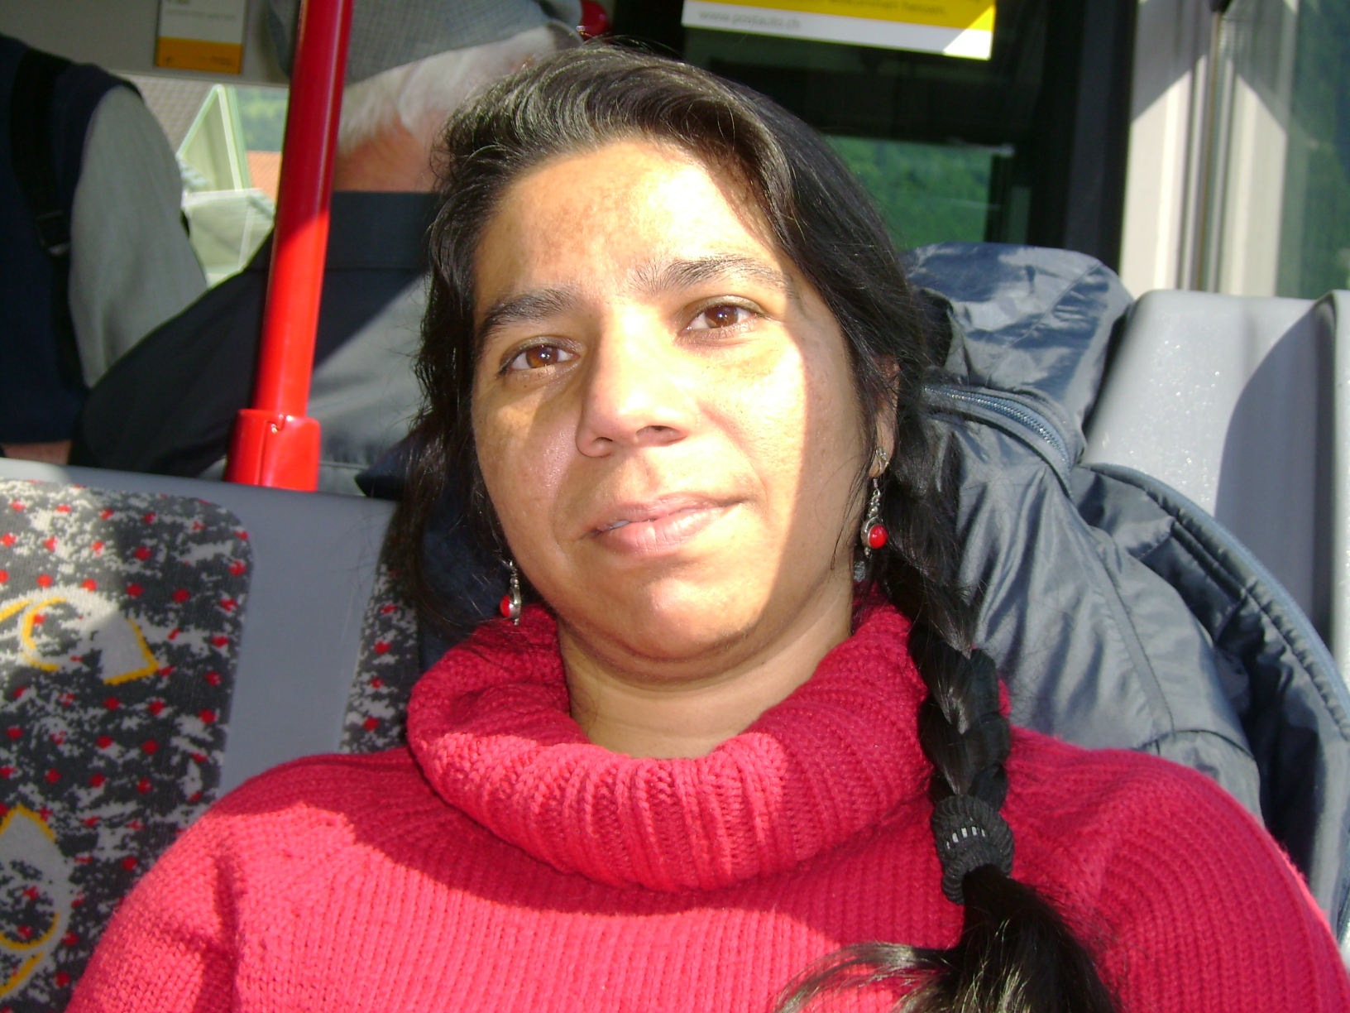
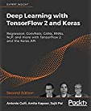

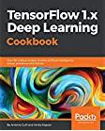

Associate Professor
Author
Advisor
Learner

Slide 3
Natural Language Processing (NLP)
Natural Language
English, Hindi, Deutsch…
Processing
Computer

Slide 4
Natural Language Processing (NLP)
Natural Language
English, Hindi, Deutsch…
Processing
Computer
NLP
Natural Language
English, Hindi, Deutsch…
Processing
Computer
Notes:
NLP: An intersection of computer science and linguistics

Slide 5
Natural Language Processing (NLP)
Natural Language
English, Hindi, Deutsch…
Processing
Computer
NLP
Natural Language
English, Hindi, Deutsch…
Processing
Computer
Computer manipulation of natural languages.

Slide 6
Natural Language Processing (NLP)
Natural Language
English, Hindi, Deutsch…
Processing
Computer
NLP
Natural Language
English, Hindi, Deutsch…
Processing
Computer
Computer manipulation of natural languages.
Set of methods/algorithms for making natural language accessible to computer.

Slide 7
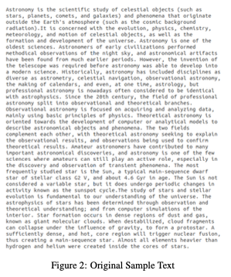
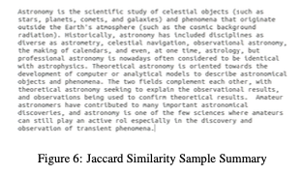
NLP Use Cases
Text Summarization
Generating concise and fluent summary of a given text
Resoomer; Summary Generator; News Papers
Image source: Comparative Study of Various Similarity Measures for Graph-Based Approach in Text Summarization, Vineeta et al, Communicated, ICON 2020

Slide 8
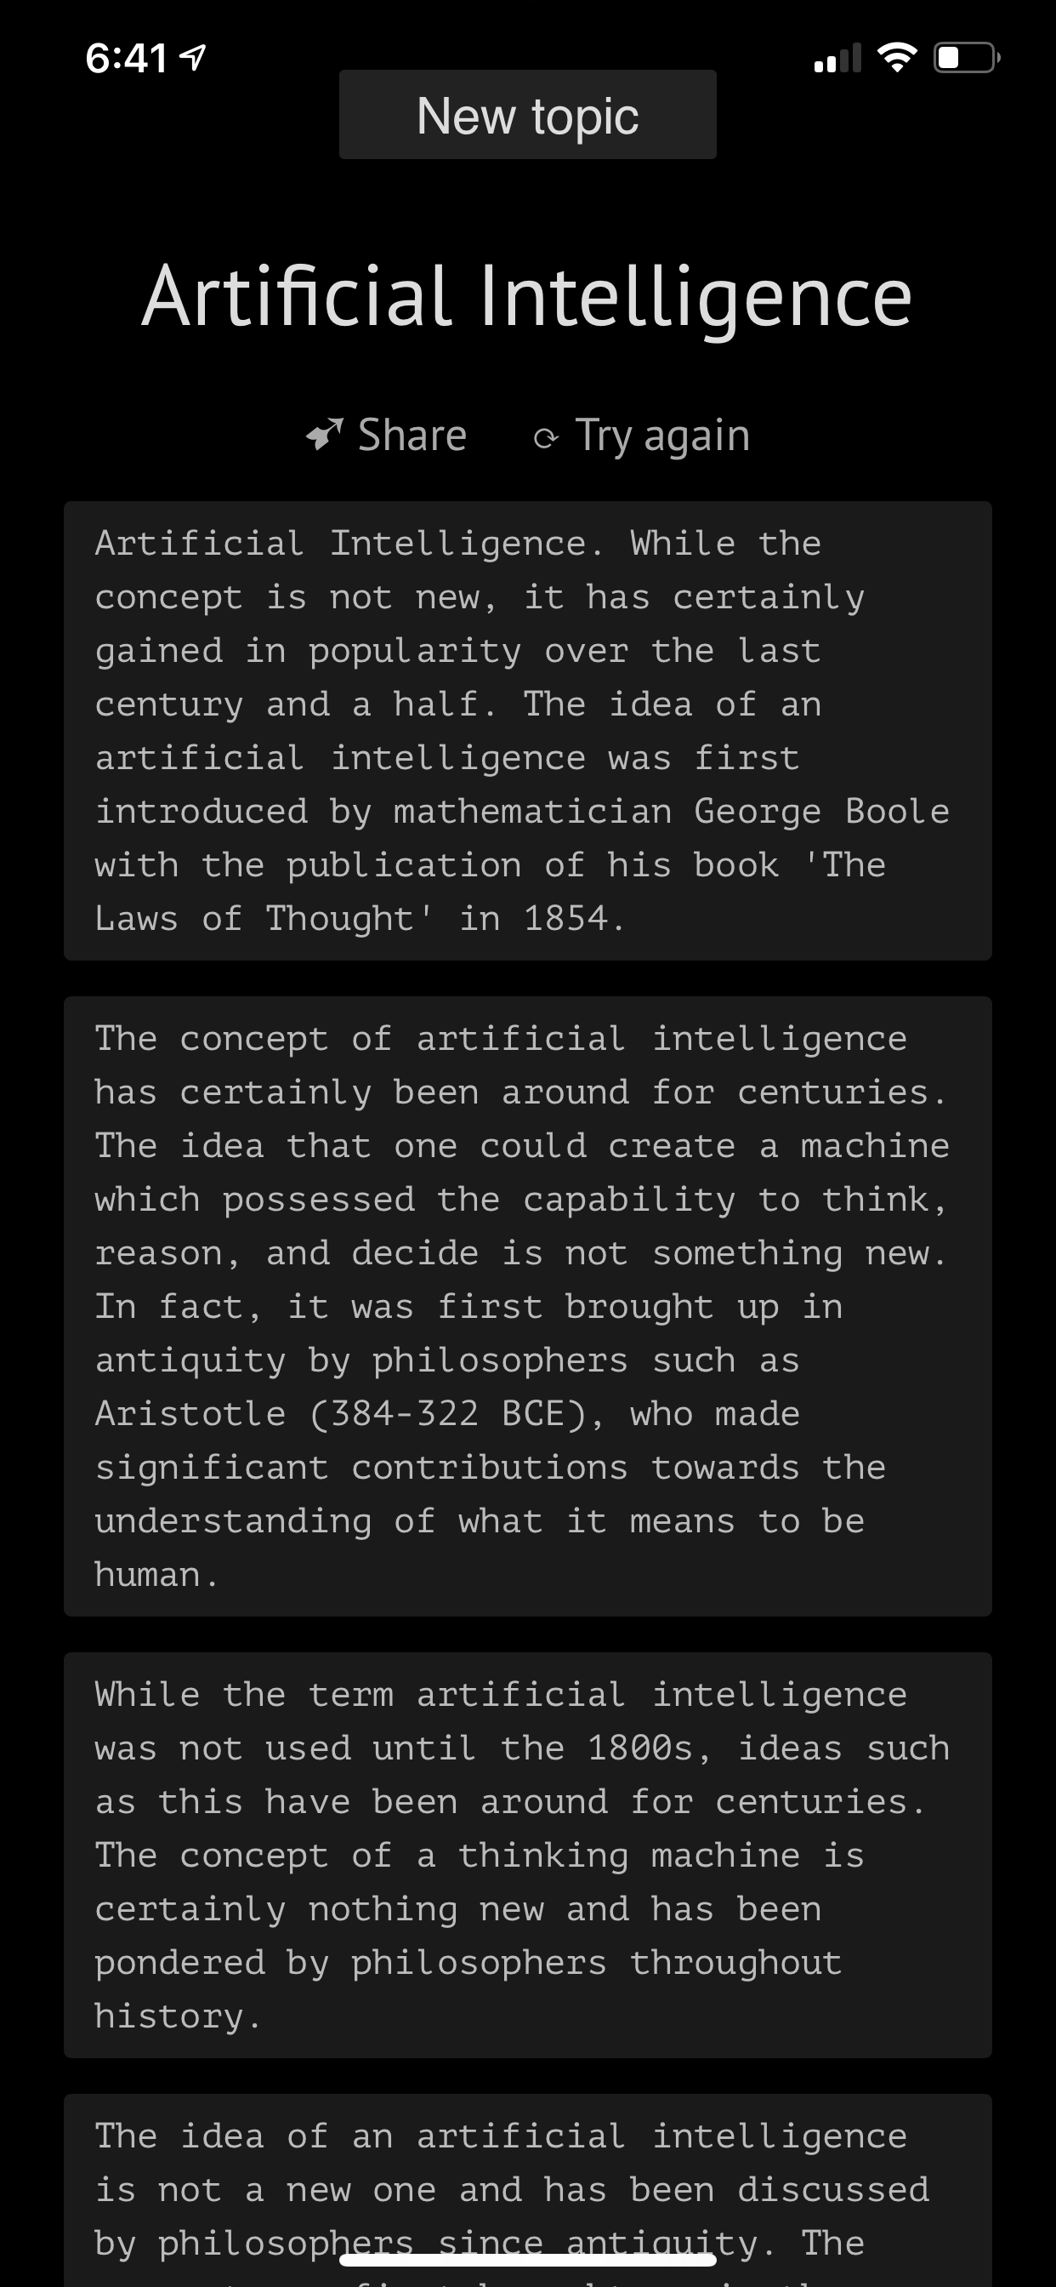
NLP Use Cases
Text Summarization
Generating concise and fluent summary of a given text
Resoomer; Summary Generator; News Papers
Text Generation
Generating new text based on input
Chatbots
Text Generated using Philosopher AI – Based on GPT 3.0 a neural network trained and hosted by OpenAI
When it is given some text, it generates predictions for what might come next. It is remarkably good at adapting to different contexts, as defined by a prompt (in this case, hidden), which sets the scene for what type of text will be generated.

Slide 9
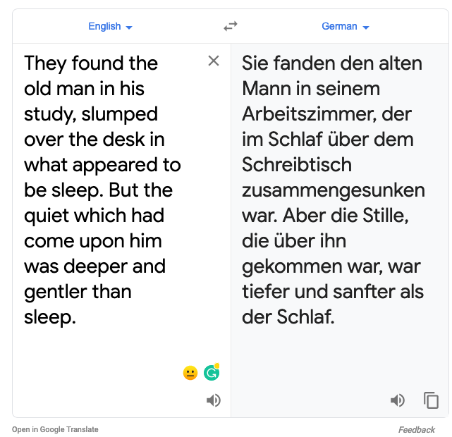
NLP Use Cases
Text Summarization
Generating concise and fluent summary of a given text
Resoomer; Summary Generator; News Papers
Machine Translation
Translating language from one language to another
Google Translate
Text Generation
Generating new text based on input
Chatbots

Slide 10
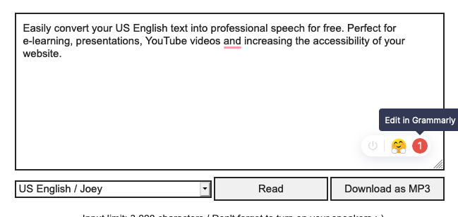

NLP Use Cases
Text Summarization
Generating concise and fluent summary of a given text
Resoomer; Summary Generator; News Papers
Machine Translation
Translating language from one language to another
Google Translate
Text to Speech
Generating synthesized speech from text.
Accessibility Services
Text Generation
Generating new text based on input
Chatbots

Slide 11
NLP Use Cases
Text Summarization
Generating concise and fluent summary of a given text
Resoomer; Summary Generator; News Papers
Machine Translation
Translating language from one language to another
Google Translate
Text to Speech
Generating synthesized speech from text.
Accessibility Services
Sentence Similarity
Finding similar sentences
Plagiarism detector
Text Generation
Generating new text based on input
Chatbots

Slide 12
NLP Use Cases
Text Summarization
Generating concise and fluent summary of a given text
Resoomer; Summary Generator; News Papers
Machine Translation
Translating language from one language to another
Google Translate
Text to Speech
Generating synthesized speech from text.
Accessibility Services
Text Classification
Classifying text into different classifiers
Spam classifiers in emails
Sentence Similarity
Finding similar sentences
Plagiarism detector
Text Generation
Generating new text based on input
Chatbots

Slide 13

NLP vs Computer Vision
1 2 3 5 6 889 6768 8989 56565 9090 6767 5665 90904 343 778 45 7979 9 4 2 9 8 5 8 0 89 4 3 w 0 8 5 3 2 4 2 3 4 0 8 2 1 2 3 5 6 889 6768 8989 56565 9090 6767 5665 90904 343 778 45 7979 9 4 2 9 8 5 8 0 89 4 3 w 0 8 5 3 2 4 2 3 4 0 8 2 1 2 3 5 6 889 6768 8989 56565 9090 6767 5665 90904 343 778 45 7979 9 4 2 9 8 5 8 0 89 4 3 w 0 8 5 3 2 4 2 3 4 0 8 2 78 89 90 45 23 99 56 23 09 22
56 90 90 67 67 56 65 90 90 4 34 3 778 45 7979 9 4 2 9 8 5 8 0 89 4 3 w 0 8 5 3 2 4 2 3 4 0 8 2 1 2 3 5 6 889 67 68 89 89 5 65 6 5 9 09 0 6 76 7 56 65 90 90 4 343 778 45 7979 9 4 2 9 8 5 8 0 89 4 3 w 0 8 5 3 2 4 2 3 4 0 8 2 1 2 3 5 6 88 9 67 68 89 89 56 565 90 90 67 67 56 65 90 90 4 34 3 7 78 45 79 79 9 4 2 9 8 5 8 0 89 4 3 w 0 8 5 3 2 4 2 3 4 0 8 2 78 89 90 45 23 99 56 23 09 22 6
56 90 90 67 67 56 65 90 90 4 34 3 778 45 7979 9 4 2 9 8 5 8 0 89 4 3 w 0 8 5 3 2 4 2 3 4 0 8 2 1 2 3 5 6 889 67 68 89 89 5 65 6 5 9 09 0 6 76 7 56 65 90 90 4 343 778 45 7979 9 4 2 9 8 5 8 0 89 4 3 w 0 8 5 3 2 4 2 3 4 0 8 2 1 2 3 5 6 88 9 67 68 89 89 56 565 90 90 67 67 56 65 90 90 4 34 3 7 78 45 79 79 9 4 2 9 8 5 8 0 89 4 3 w 0 8 5 3 2 4 2 3 4 0 8 2 78 89 90 45 23 99 56 23 09 22

Slide 14
NLP vs Computer Vision
A B C D
ASCII encoding
1 2 3 5 6 889 6768 8989 56565 9090 6767 5665 90904 343 778 45 7979 9 4 2 9 8 5 8 0 89 4 3 w 0 8 5 3 2 4 2 3 4 0 8 2 1 2 3 5 6 889 6768 8989 56565 9090 6767 5665 90904 343 778 45 7979 9 4 2 9 8 5 8 0 89 4 3 w 0 8 5 3 2 4 2 3 4 0 8 2 1 2 3 5 6 889 6768 8989 56565 9090 6767 5665 90904 343 778 45 7979 9 4 2 9 8 5 8 0 89 4 3 w 0 8 5 3 2 4 2 3 4 0 8 2 78 89 90 45 23 99 56 23 09 22
56 90 90 67 67 56 65 90 90 4 34 3 778 45 7979 9 4 2 9 8 5 8 0 89 4 3 w 0 8 5 3 2 4 2 3 4 0 8 2 1 2 3 5 6 889 67 68 89 89 5 65 6 5 9 09 0 6 76 7 56 65 90 90 4 343 778 45 7979 9 4 2 9 8 5 8 0 89 4 3 w 0 8 5 3 2 4 2 3 4 0 8 2 1 2 3 5 6 88 9 67 68 89 89 56 565 90 90 67 67 56 65 90 90 4 34 3 7 78 45 79 79 9 4 2 9 8 5 8 0 89 4 3 w 0 8 5 3 2 4 2 3 4 0 8 2 78 89 90 45 23 99 56 23 09 22 6
56 90 90 67 67 56 65 90 90 4 34 3 778 45 7979 9 4 2 9 8 5 8 0 89 4 3 w 0 8 5 3 2 4 2 3 4 0 8 2 1 2 3 5 6 889 67 68 89 89 5 65 6 5 9 09 0 6 76 7 56 65 90 90 4 343 778 45 7979 9 4 2 9 8 5 8 0 89 4 3 w 0 8 5 3 2 4 2 3 4 0 8 2 1 2 3 5 6 88 9 67 68 89 89 56 565 90 90 67 67 56 65 90 90 4 34 3 7 78 45 79 79 9 4 2 9 8 5 8 0 89 4 3 w 0 8 5 3 2 4 2 3 4 0 8 2 78 89 90 45 23 99 56 23 09 22
I went to grocery shopping today
?

Slide 15
NLP pipeline
Raw Text
Documents
Pdfs
Tweets
Emails
Feature Extraction
Embeddings
Model
Text Processing
Text Normalization
Convert to lowercase
Remove Punctuation
Remove special characters
Tokenization
Split sentences to words.
Stemming
Replace words by their stem words.
Lemmatization
Get the root form.

Slide 16
NLP pipeline
Raw Text
Documents
Pdfs
Tweets
Emails
Feature Extraction
Embeddings
Model
Text Processing
Text Normalization
Convert to lowercase
Remove Punctuation
Remove special characters
Tokenization
Split sentences to words.
Stemming
Replace words by their stem words.
Lemmatization
Get the root form.

Slide 17
Text Normalization
Convert to lowercase
Remove punctuation/special characters
text = ‘Apple fell on the ground’
text = text.lower()
Apple fell on the ground
apple fell on the ground
import re
text = ‘”wow! it was great“’
text = re.sub(r"[^a-zA-Z0-9]", " ", text)
“wow! it was great”
wow it was great

Slide 18
Tokenization
Process of splitting a phrase, sentence or entire text into smaller units, like individual words or terms.
These smaller units are called tokens.
The tokens are assigned integral values so that they can be processed by computer
“Arise, awake and stop not till the goal is reached”
[“Arise”, “awake”, “and”, ”stop”, “not”, “till”, “the”, “goal”, “is”, “reached”]

Slide 19
Tokenization
Process of splitting a phrase, sentence or entire text into smaller units, like individual words or terms.
These smaller units are called tokens.
The tokens are assigned integral values so that they can be processed by computer
“Arise, awake and stop not till the goal is reached”
[23, 54, 4, 17, 22, 78, 65, 32, 3, 72]

Slide 20
Stemming and Lemmatization
friend
friendship
friends
friendships
was
are
is
be
friend
be
Goal is to reduce inflectional forms and sometimes derivationally related forms of a word to a common base form.
Stemming – removes derivational affixes like- ‘s’, ‘ship’
Lemmatization – returns base or dictionary form of a word (lemma).
A good tutorial: https://www.datacamp.com/community/tutorials/stemming-lemmatization-python

Slide 21
Feature Extraction
Two major methods
Bag of Words (BoW)
Term Frequency-Inverse document Frequency (TF-IDF)

Slide 22
Feature Extraction- BoW
Bag of Words (BoW)
A vocabulary of known words.
Measure the occurrence of known words.
Order of words is not important

Slide 23
Feature Extraction- BoW
Bag of Words (BoW)
A vocabulary of known words.
Measure the occurrence of known words.
Order of words is not important – hence ‘bag’
Let us consider few lines from Charles Dickens-”A tale of two cities”
It was the best of times, it was the worst of times, it was the age of wisdom, it was the age of foolishness,

Slide 24
Feature Extraction- BoW
It was the best of times, it was the worst of times, it was the age of wisdom, it was the age of foolishness,
Unique words in our corpus:
“it”
“was”
“the”
“best”
“of”
“times”
“worst”
“age”
“wisdom”
“foolishness”

Slide 25
Feature Extraction- BoW
Unique words in our corpus:
“it”
“was”
“the”
“best”
“of”
“times”
“worst”
“age”
“wisdom”
“foolishness”
We can represent our document as vector of length 10, with term-frequency (TF) of each word as its value.

Slide 26
Feature Extraction- BoW
We can represent our document as vector of length 10, with term frequency (TF) of each word as its value.
Document | it | was | the | best | of | times | worst | age | wisdom | foolishness
It was the best of times | 1 | 1 | 1 | 1 | 1 | 1 | 0 | 0 | 0 | 0
it was the worst of times | 1 | 1 | 1 | 0 | 1 | 1 | 1 | 0 | 0 | 0
it was the age of wisdom | 1 | 1 | 1 | 0 | 1 | 0 | 0 | 1 | 1 | 0
it was the age of foolishness | 1 | 1 | 1 | 0 | 1 | 0 | 0 | 1 | 0 | 1
As the vocabulary increases the size of vectors increases.
Lot of zeros– sparse matrices.
A better way – n-gram: consider ‘n’ group of words together.
BoW is one gram model
Problem:
Some words may have very high frequency so will dominate

Slide 27
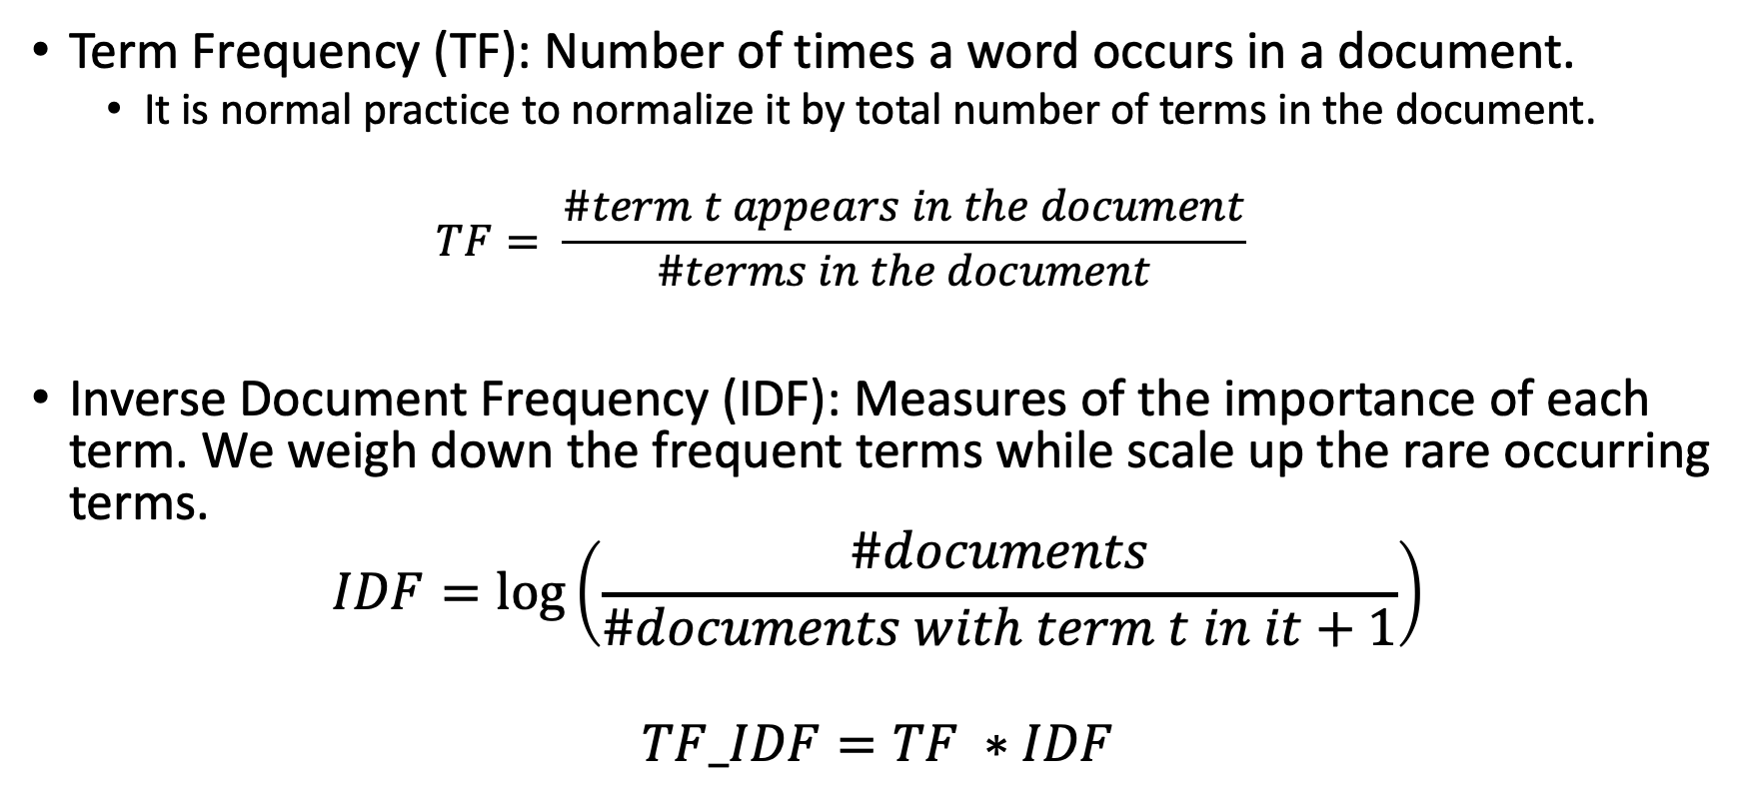
Feature Extraction- TF-IDF
Term Frequency (TF): Number of times a word occurs in a document.
It is normal practice to normalize it by total number of terms in the document.
$$TF= \frac{\#term t appears in the document}{\#terms in the document}$$
Inverse Document Frequency (IDF): Measures of the importance of each term. We weigh down the frequent terms while scale up the rare occurring terms.
$$IDF=log⁡\left(\frac{\#documents}{\#documents with term t in it+1}\right)$$
$$TF_IDF=TF ∗IDF$$

Slide 28

Text Processing + Feature Extraction How do we do it?

Slide 29
Text Processing: TensorFlow
tf.keras.preprocessing.text.Tokenizer()
tf.keras.preprocessing.text.Tokenizer( num_words=None, filters='!"#$%&()*+,-./:;<=>?@[\\]^_`{|}~\t\n', lower=True, split=' ', char_level=False, oov_token=None, document_count=0, **kwargs )
“This class allows to vectorize a text corpus, by turning each text into either a sequence of integers (each integer being the index of a token in a dictionary) or into a vector where the coefficient for each token could be binary, based on word count, based on tf-idf.”

Slide 30
Text Processing: TensorFlow
tf.keras.preprocessing.text.Tokenizer()
fit_on_texts Updates internal vocabulary based on a list of texts. This method creates the vocabulary index based on word frequency. So if you give it something like, "The cat sat on the mat." It will create a dictionary “word_index” such that every word gets a unique integer value. 0 is reserved for padding. So lower integer means more frequent word.
texts_to_sequences Transforms each text in texts to a sequence of integers. It takes each word in the text and replaces it with its corresponding integer value from the word_index dictionary.

Slide 31
Text Processing: TensorFlow
tf.keras.preprocessing.text.Tokenizer()
fit_on_texts Updates internal vocabulary based on a list of texts. This method creates the vocabulary index based on word frequency. So if you give it something like, "The cat sat on the mat." It will create a dictionary “word_index” such that every word gets a unique integer value. 0 is reserved for padding. So lower integer means more frequent word.
texts_to_sequences Transforms each text in texts to a sequence of integers. It takes each word in the text and replaces it with its corresponding integer value from the word_index dictionary.

Slide 32
Text Processing: TensorFlow
tf.keras.preprocessing.text.Tokenizer()
from tensorflow.keras.preprocessing.text import Tokenizer
t = Tokenizer()
fit_text = ["In science, you can say things that seem crazy, but in the long run, they can turn out to be right"]
t.fit_on_texts(fit_text)
test_text1 = "I would like to take a right turn"
test_text2 = "That man is crazy"
sequences = t.texts_to_sequences([test_text1, test_text2])
print('sequences : ',sequences,'\n')
print('word_index : ',t.word_index)

Slide 33
Text Processing: TensorFlow
tf.keras.preprocessing.text.Tokenizer()
from tensorflow.keras.preprocessing.text import Tokenizer
t = Tokenizer()
fit_text = ["In science, you can say things that seem crazy, but in the long run, they can turn out to be right"]
t.fit_on_texts(fit_text)
test_text1 = "I would like to take a right turn"
test_text2 = "That man is crazy"
sequences = t.texts_to_sequences([test_text1, test_text2])
print('sequences : ',sequences,'\n')
print('word_index : ',t.word_index)
sequences : [[17, 19, 15], [7, 9]]
word_index : {'in': 1, 'can': 2, 'science': 3, 'you': 4, 'say': 5, 'things': 6, 'that': 7,
'seem': 8, 'crazy': 9, 'but': 10, 'the': 11, 'long': 12, 'run': 13, 'they': 14,
'turn': 15, 'out': 16, 'to': 17, 'be': 18, 'right': 19}

Slide 34
NLP pipeline
Raw Text
Documents
Pdfs
Tweets
Emails
Feature Extraction
Embeddings
Model
Text Processing
Text Normalization
Convert to lowercase
Remove Punctuation
Remove special characters
Tokenization
Split sentences to words.
Stemming
Replace words by their stem words.
Lemmatization
Get the root form.

Slide 35
Embeddings
Mapping words (integers) to real numbers.
Earlier approaches were to one hot encode. So if we have 3000 unique words we will use a vector with 3000 bits to encode each word uniquely.
word_index : {'in': 1, 'can': 2, 'science': 3, 'you': 4, 'say': 5, 'things': 6, 'that': 7,
'seem': 8, 'crazy': 9, 'but': 10, 'the': 11, 'long': 12, 'run': 13, 'they': 14,
'turn': 15, 'out': 16, 'to': 17, 'be': 18, 'right': 19}

Slide 36
Embeddings
Mapping words (integers) to real numbers.
Misses the relationship between the words:
You ←→ They
Man ←→ Woman
Door ←→Window
word_index : {'in': 1, 'can': 2, 'science': 3, 'you': 4, 'say': 5, 'things': 6, 'that': 7,
'seem': 8, 'crazy': 9, 'but': 10, 'the': 11, 'long': 12, 'run': 13, 'they': 14,
'turn': 15, 'out': 16, 'to': 17, 'be': 18, 'right': 19}

Slide 37
Embeddings
"You shall know a word by the company it keeps."
-John Rupert Firth
Consider the following pair of sentences:
Paris is the capital of France.
Berlin is the capital of Germany.
"Paris" is to "France" as "Berlin" is to "Germany”
There exists some transformation ⏀such that:
⏀(“Paris”) - ⏀(“France) ~ ⏀(“Berlin”) - ⏀(“Germany”)

Slide 38
Embeddings
Word mappings such that similar words with similar meanings have a similar representation.
In terms of vectors – we can say the vectors representing them have small distances.
Thus the embeddings capture the semantic relationships, meanings and the context, the words are used in.
Words that occur in similar contexts tend to have similar meanings.
Word embeddings result in dense, low-dimensional vectors.

Slide 39
Embeddings-Distributed Representations
Word mappings such that similar words with similar meanings have a similar representation.
In terms of vectors – we can say the vectors representing them have small distances.
Thus the embeddings capture the semantic relationships, meanings and the context, the words are used in.
Words that occur in similar contexts tend to have similar meanings.
Word embeddings result in dense, low-dimensional vectors.

Slide 40

Image source: http://hunterheidenreich.com/blog/intro-to-word-embeddings/

Slide 41
Embeddings
Train your own embeddings
Use existing pre-trained embeddings
Word2Vec
GloVe- Global vectors for word representation
Fine Tune the pre-trained embeddings for your corpus

Slide 42
Word2Vec
Developed by Google in year 2013
Trained on about 100 billion words.
It is self-supervised, that is, it is a supervised model that depend on the structure of natural language to provide labelled training data.
It has two architectures:
Continuous Bag of Words (CBOW):
The model predicts the current word given a window of surrounding words.
Skip-gram:
The model predicts the surrounding words given the context word.

Slide 43
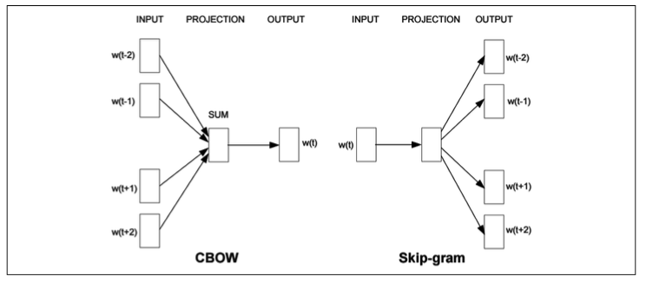
Word2Vec-CBOW
“The Earth travels around the Sun once per year.”
Assume Window size: 5

Slide 44
Word2Vec-CBOW
“The Earth travels around the Sun once per year.”
Assume Window size: 5

Slide 45
Word2Vec-CBOW
“The Earth travels around the Sun once per year.”
Assume Window size: 5

Slide 46
Word2Vec-CBOW
“The Earth travels around the Sun once per year.”
Assume Window size: 5

Slide 47
Word2Vec-Skip Gram
“The Earth travels around the Sun once per year.”
Positive Samples
[[The, Earth],1]
[[The, travels],1]
[[Earth, The],1]
[[Earth, travels],1]
[[Earth, around],1]
[[Travels, The],1]
[[Travels, Earth],1]
[[Travels, around],1]
[[Travels, the],1]

Slide 48
Word2Vec-Skip Gram
“The Earth travels around the Sun once per year.”
Positive Samples
Negative Samples
[[The, Earth],1]
[[The, travels],1]
[[Earth, The],1]
[[Earth, travels],1]
[[Earth, around],1]
[[Travels, The],1]
[[Travels, Earth],1]
[[Travels, around],1]
[[Travels, the],1]
[[The, per],0]
[[The, year],0]
[[Earth, year],0]

Slide 49
Word2Vec-Skip Gram Negative Sampling
“The Earth travels around the Sun once per year.”
Positive Samples
Negative Samples
[[The, Earth],1]
[[The, travels],1]
[[Earth, The],1]
[[Earth, travels],1]
[[Earth, around],1]
[[Travels, The],1]
[[Travels, Earth],1]
[[Travels, around],1]
[[Travels, the],1]
[[The, per],0]
[[The, year],0]
[[Earth, year],0]

Slide 50
Word2Vec
CBOW is faster but skip-gram does a better job at predicting infrequent words.

Slide 51
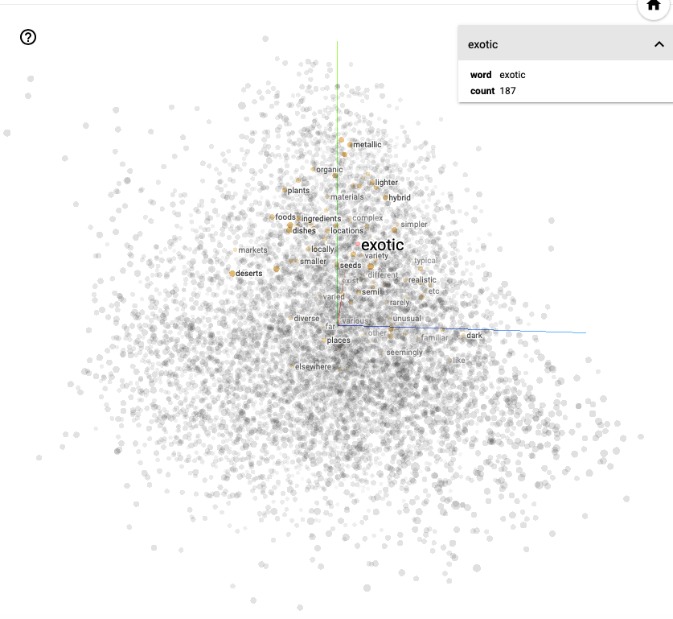
Word2Vec Example
Embeddings Projector

Slide 52
Word2Vec Example
Co-occurrence of words one at a time
Embeddings Projector

Slide 53
GloVe- Global vectors for word representation
Created by Jeffrey Pennington, Richard Socher, and Christopher Manning in year 2014.
An unsupervised learning algorithm for obtaining vector representations for words.
A count-based model – considers co-occurrence of words in the entire corpus.

Slide 54
GloVe- Global vectors for word representation
Large Matrix of (word, context) pairs that co-occur
Rows correspond to words and columns correspond to contexts
Each element of the matrix represents how often the word co-occurs in the context.
Learn word vectors such that their dot product equals the logarithm of the words' probability of co-occurrence.
Use Gradient descent to minimize the difference.

Slide 55
GloVe- Global vectors for word representation
 | it | was | the | best | of | times | worst | age | wisdom | foolishness
it | 0 | 4 | 0 | 0 | 0 | 0 | 0 | 0 | 0 | 0
was | 4 | 0 | 4 | 0 | 0 | 0 | 0 | 0 | 0 | 0
the | 0 | 4 | 0 | 1 | 0 | 0 | 1 | 2 | 0 | 0
best | 1 | 1 | 1 | 0 | 1 | 0 | 0 | 1 | 0 | 1
of | 0 | 0 | 0 | 1 | 0 | 2 | 1 | 2 | 1 | 1
times | 0 | 0 | 0 | 0 | 2 | 0 | 0 | 0 | 0 | 0
worst | 0 | 0 | 1 | 0 | 1 | 0 | 0 | 0 | 0 | 0
age | 0 | 0 | 2 | 0 | 2 | 0 | 0 | 0 | 0 | 0
wisdom | 0 | 0 | 0 | 0 | 1 | 0 | 0 | 0 | 0 | 0
foolishness | 0 | 0 | 0 | 0 | 1 | 0 | 0 | 0 | 0 | 0
Corpus
It was the best of times, it was the worst of times, it was the age of wisdom, it was the age of foolishness,

Slide 56
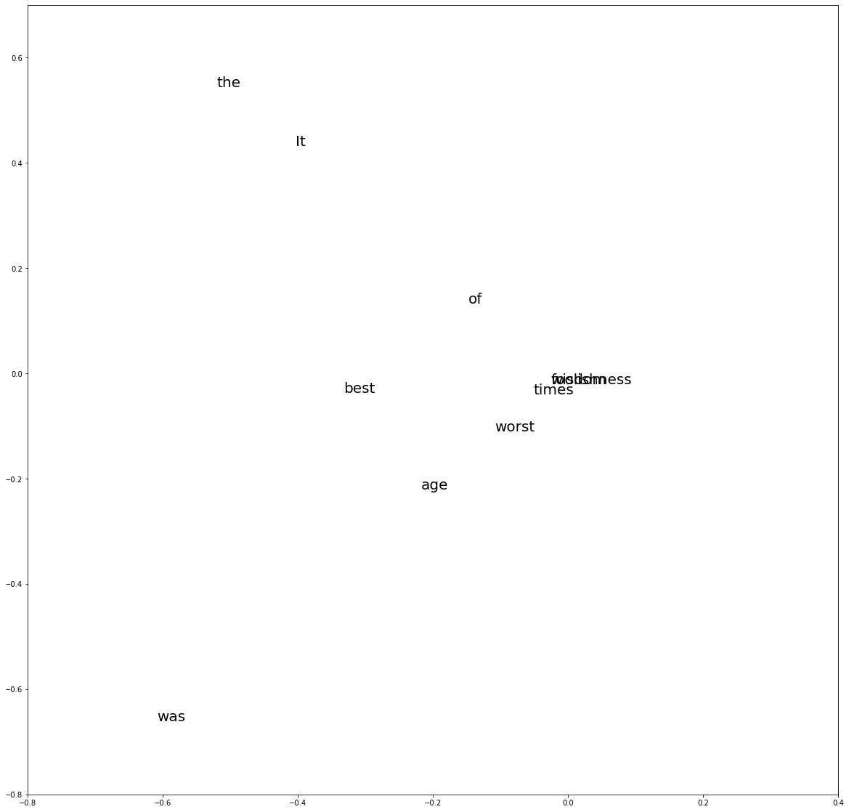
GloVe- Global vectors for word representation
Corpus
It was the best of times, it was the worst of times, it was the age of wisdom, it was the age of foolishness,

Slide 57
NLP pipeline
Raw Text
Documents
Pdfs
Tweets
Emails
Feature Extraction
Embeddings
Model
Text Processing
Text Normalization
Convert to lowercase
Remove Punctuation
Remove special characters
Tokenization
Split sentences to words.
Stemming
Replace words by their stem words.
Lemmatization
Get the root form.

Slide 58
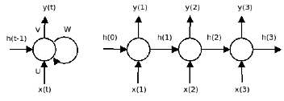
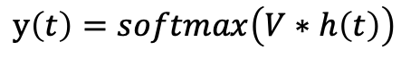
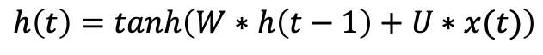
Recurrent Neural Networks
Feedback: output (hidden state h_{t-1}) is fed back to the input.
Hidden state thus acts as a memory of the previous state
Useful for sequential information.
y(t)
y(1)
y(2)
y(3)
V
W
h(0)
h(1)
h(2)
h(3)
$$h\left(t\right)=tanh\left(W∗h\left(t−1\right)+U∗x(t)\right)$$
h(t-1)
$$y\left(t\right)=softmax\left(V∗h\left(t\right)\right)$$
U
x(t)
x(1)
x(2)
x(3)
Basic RNN Cell
Unrolled RNN cell with 3 time steps

Slide 59
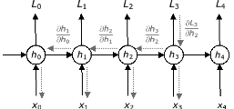
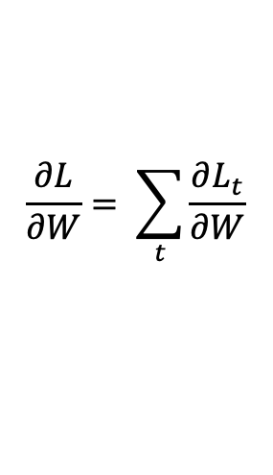
Learns through BPTT
$$\frac{∂L}{∂W}= \sum_{t}{\frac{∂L_{t}}{∂W}}$$
Vanishing gradients - gradients become zero as a result learning stops
Exploding gradients - gradients become too large, thus one feature dominates at the cost of others.

Slide 60
RNN Variants
LSTM - Long Short Term Networks
GRU – Gated Recurrent Unit
Peephole LSTM
Bidirectional RNNs

Slide 61
RNN Variants
LSTM - Long Short Term Networks
GRU – Gated Recurrent Unit
Peephole LSTM
Bidirectional RNNs

Slide 62
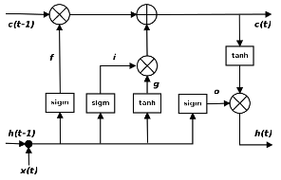
LSTM Cell
Forget gate defines how much of the previous state h_{t-1} you want to allow to pass through.
Input gate defines how much of the newly computed state for the current input x_{t} you want to let through.
Output gate defines how much of the internal state you want to expose to the next layer.

Slide 63
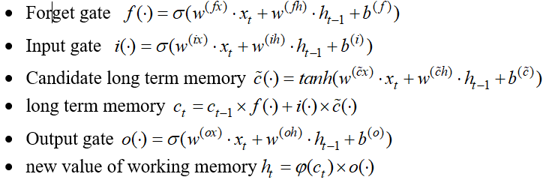
LSTM Cell

Slide 64
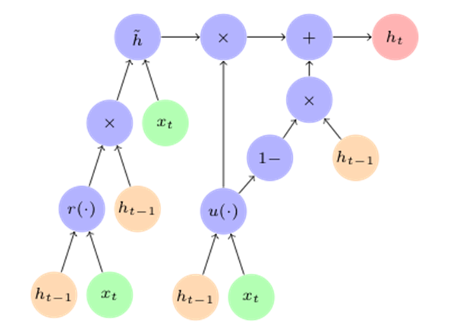
GRU Cell
Has only two gates
Update Gate u: defines how much previous memory to keep around
Reset Gate r: Defines how to combine the new input with the previous memory
r(.)
U(.)

Slide 65
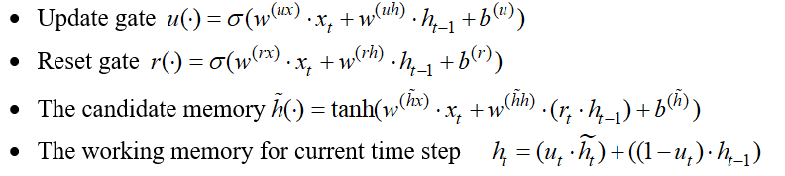
GRU Cell

Slide 66
Code Walkthrough
Creating your own embedding using gensim
SPAM Detection
Sentiment Analysis.

